Slide 1

Multi-task Self-Supervised Object Detection via Recycling of Bounding Box Annotations
2019-07-08 Wonhee Lee (wonhee@vision.snu.ac.kr)

Slide 2
Multi-task Self-Supervised Object Detection via Recycling of Bounding Box Annotations
①
②
③

Slide 3
Objectives
Improving the object detection accuracy
The two requisites for object detection
Novel detector & backbone network
Lots of bounding box annotations
Additional ways
Multi-task learning
Self-supervised learning
Annotation reusing

Slide 4
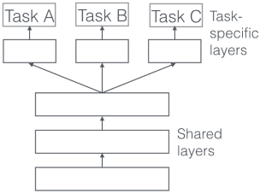
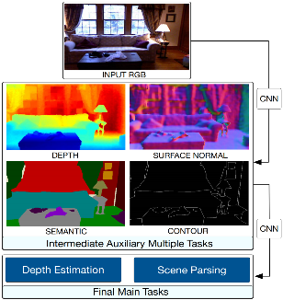
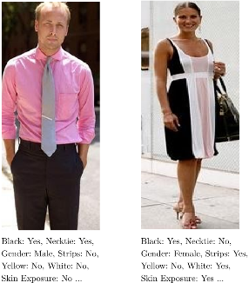
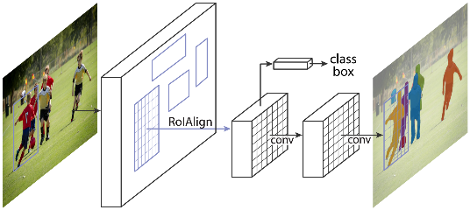
Introduction - MTL
Multi-task learning (MTL)
Cooperative feature learning by several tasks
Synergetic when tasks are related to each other

Slide 5
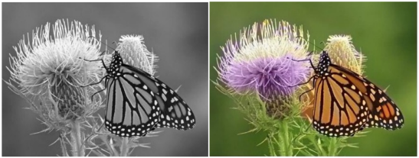
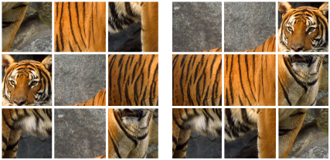
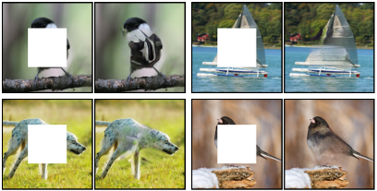
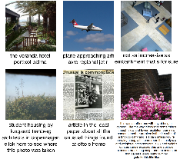
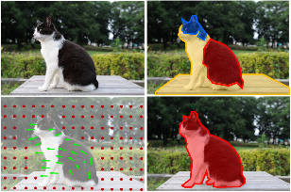
Introduction - SSL
Self-supervised learning (SSL)
annotated without any human effort
Mostly for pretraining
performance: random init. < self-supervision pretraining < ImageNet pretraining

Slide 6
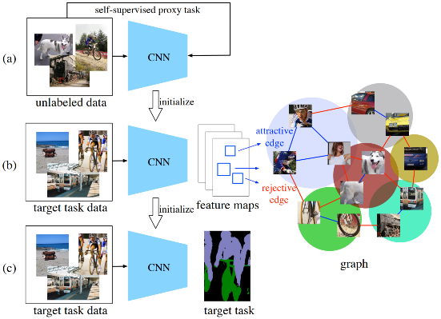
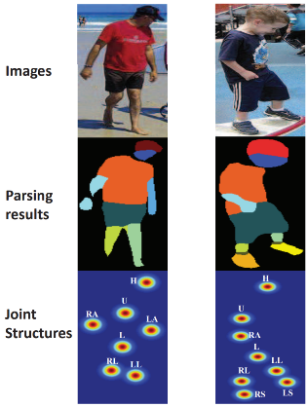
Introduction - Annotation Recycling
Why Recycling?
used to create detection loss
used again to create losses of auxiliary tasks
extract information in the label to the extreme
To boost up the main task
Mix & Match task by recycling segmentation label
Joint structure prediction by recycling segmentation label

Slide 7
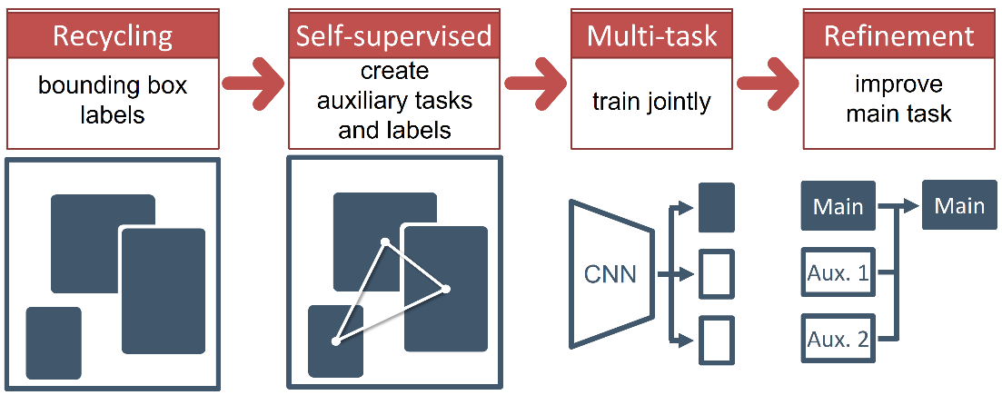
Our Idea
Start from the conventional detection setting with BBox annotations
Extract additional information in the annotations (Recycling)
Create three auxiliary tasks that predict it (SSL)
Cooperative feature learning (MTL)
Refine the classification result using the output of auxiliary tasks

Slide 8
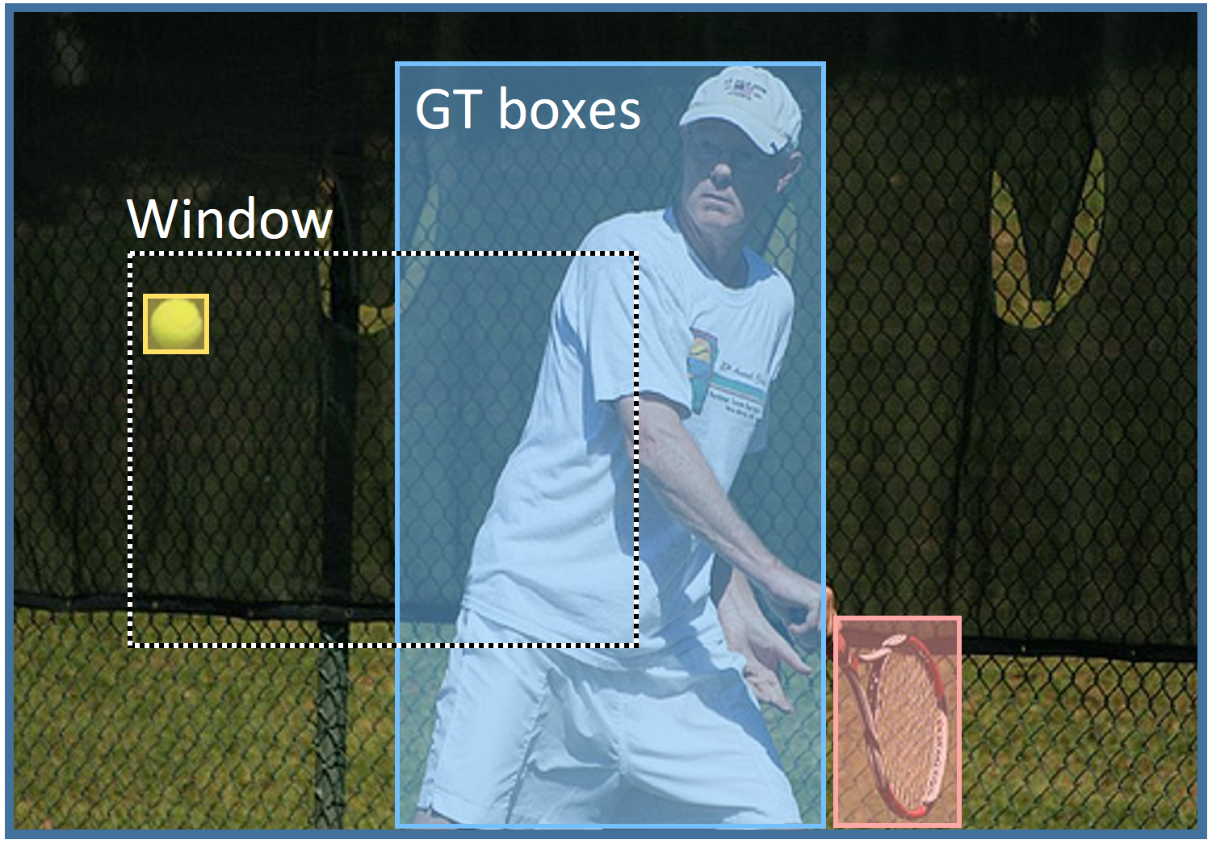
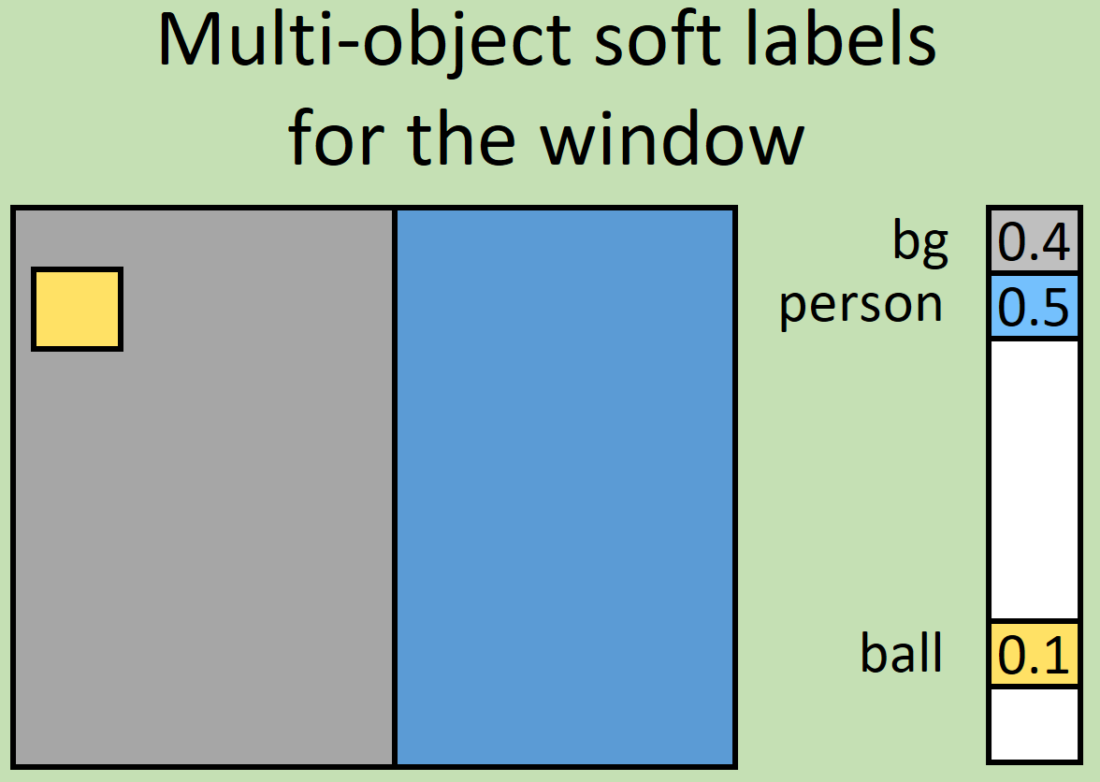
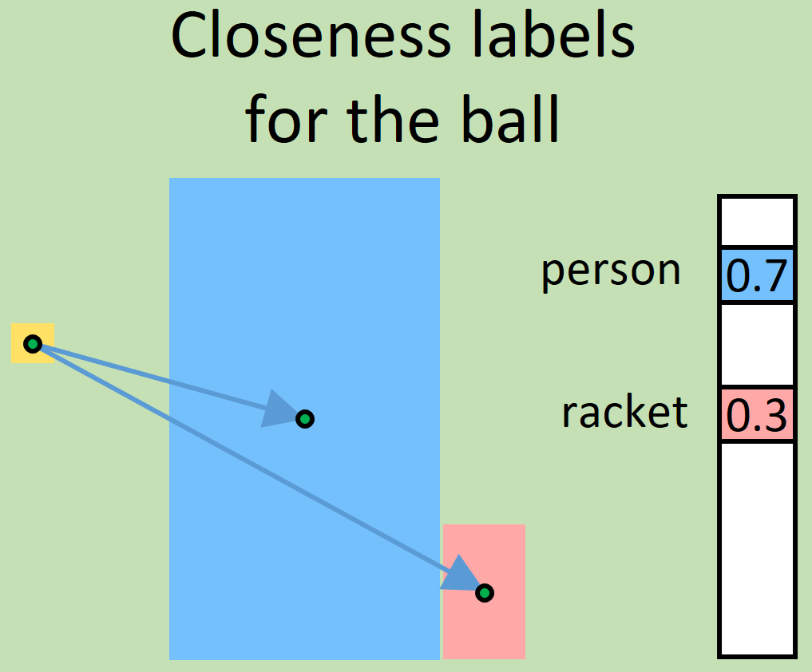
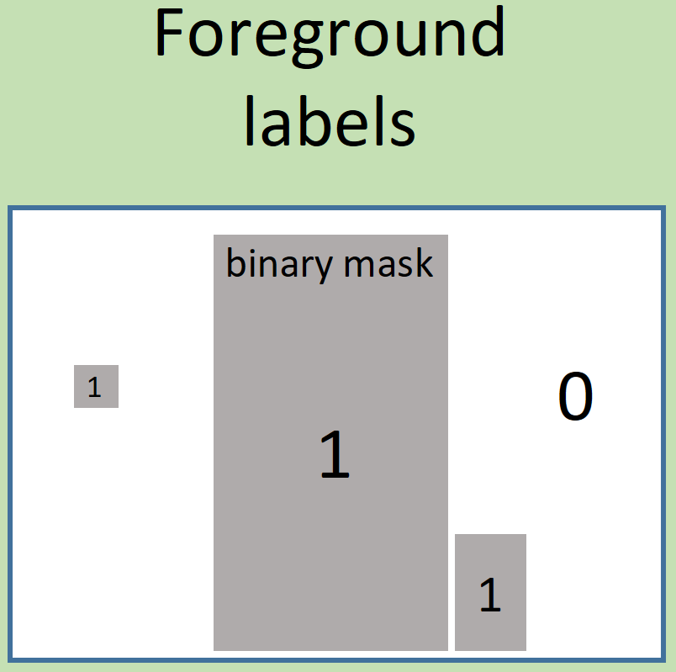
Approach - 3 auxiliary tasks
Multi-object labeling
Closeness labeling
Foreground labeling

Slide 9
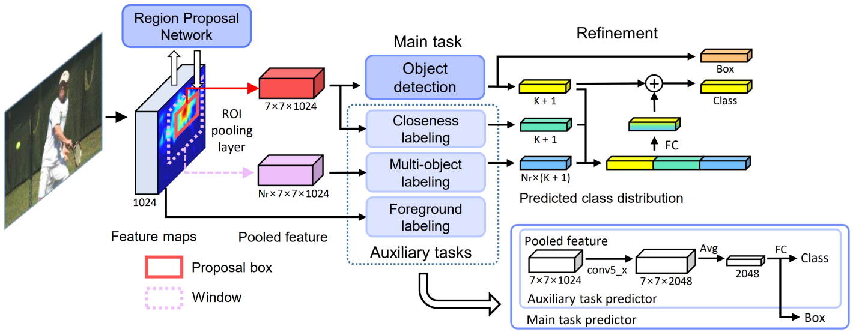
Approach - architecture
How object detection improves?
Multi-task learning: cooperative feature learning
Refinement: using contextual information in the auxiliary task output

Slide 10
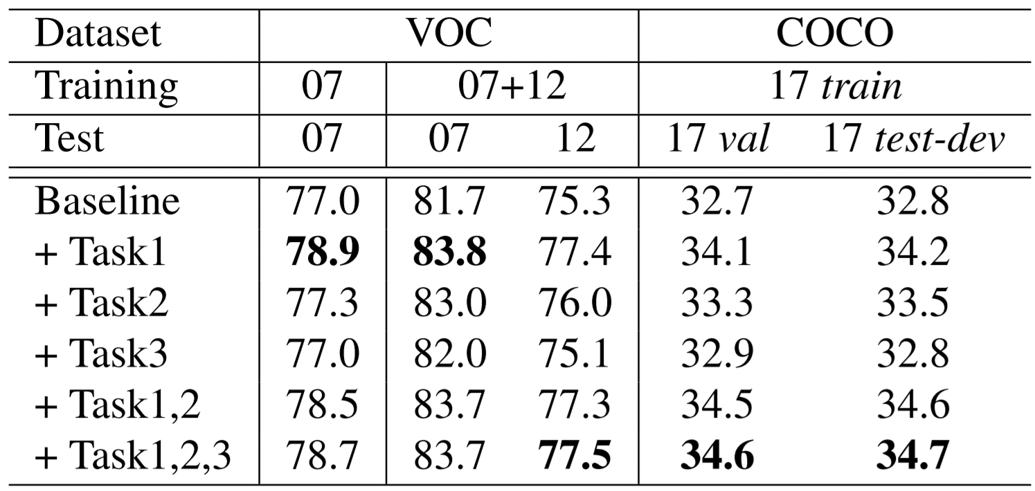
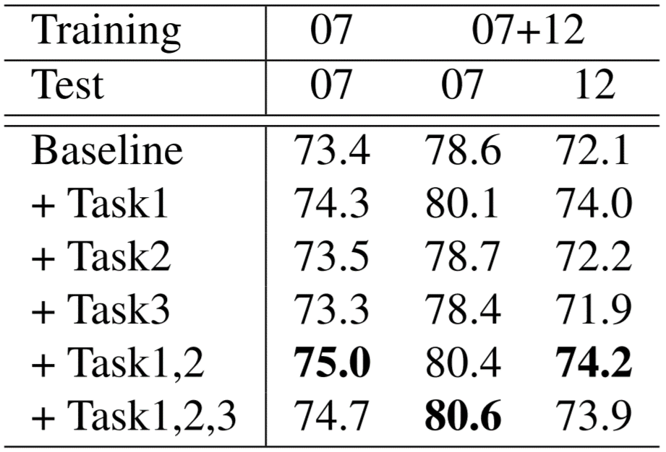
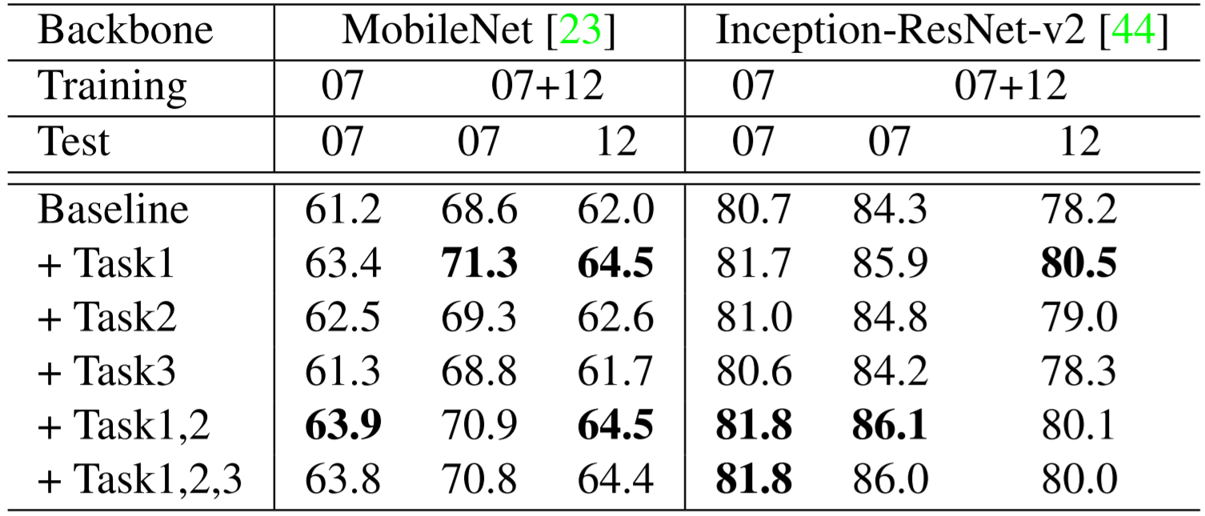
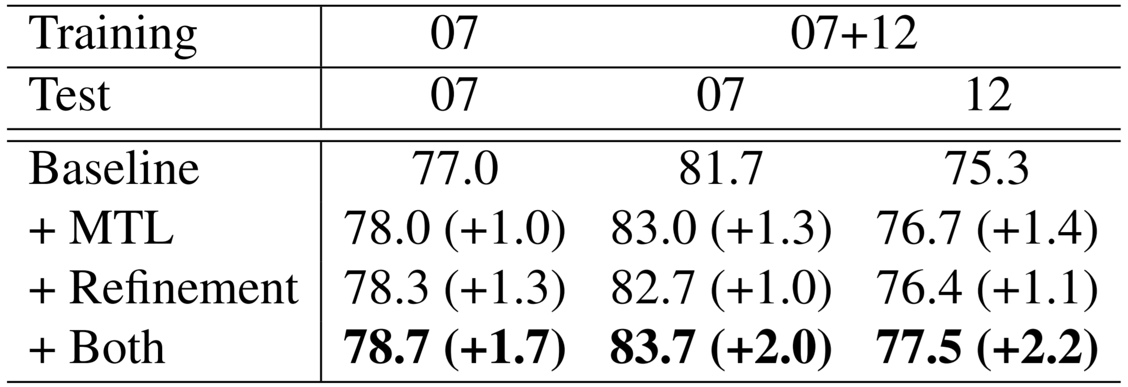
Experiments
2.0 mAP ↑ on average
Dataset
Base Detector (R-FCN)
Backbone Networks
Ablations

Slide 11
Contributions
A first attempt to recycle BBox annotations for object detection
Orthogonal to any proposal-based detection models
Improvement (mAP 2.0↑ on avg) in multiple architectures

Slide 12
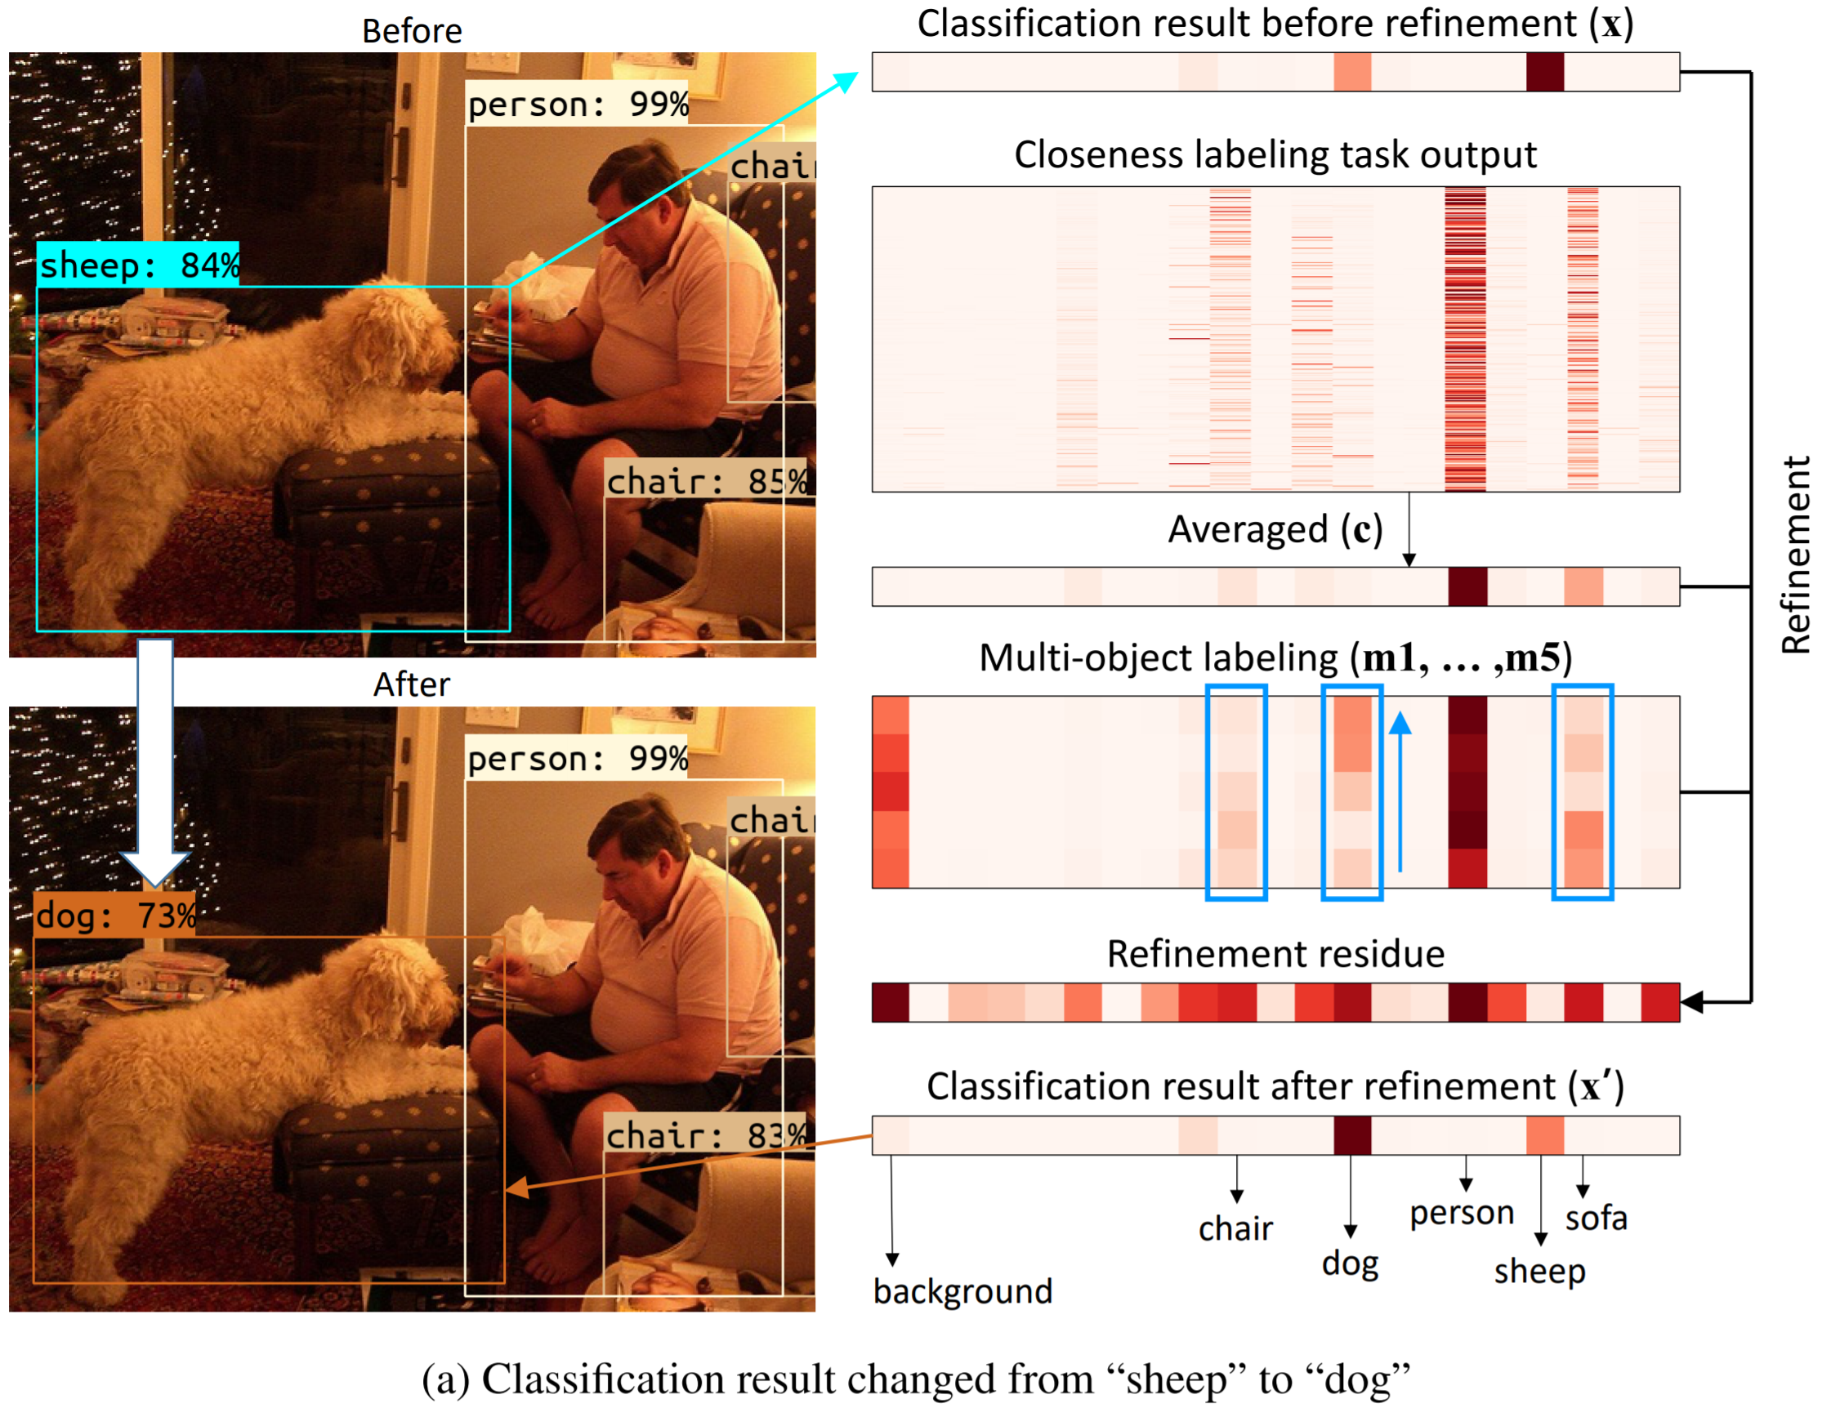
Visualization - Refinement
By multi-object labeling task

Slide 13
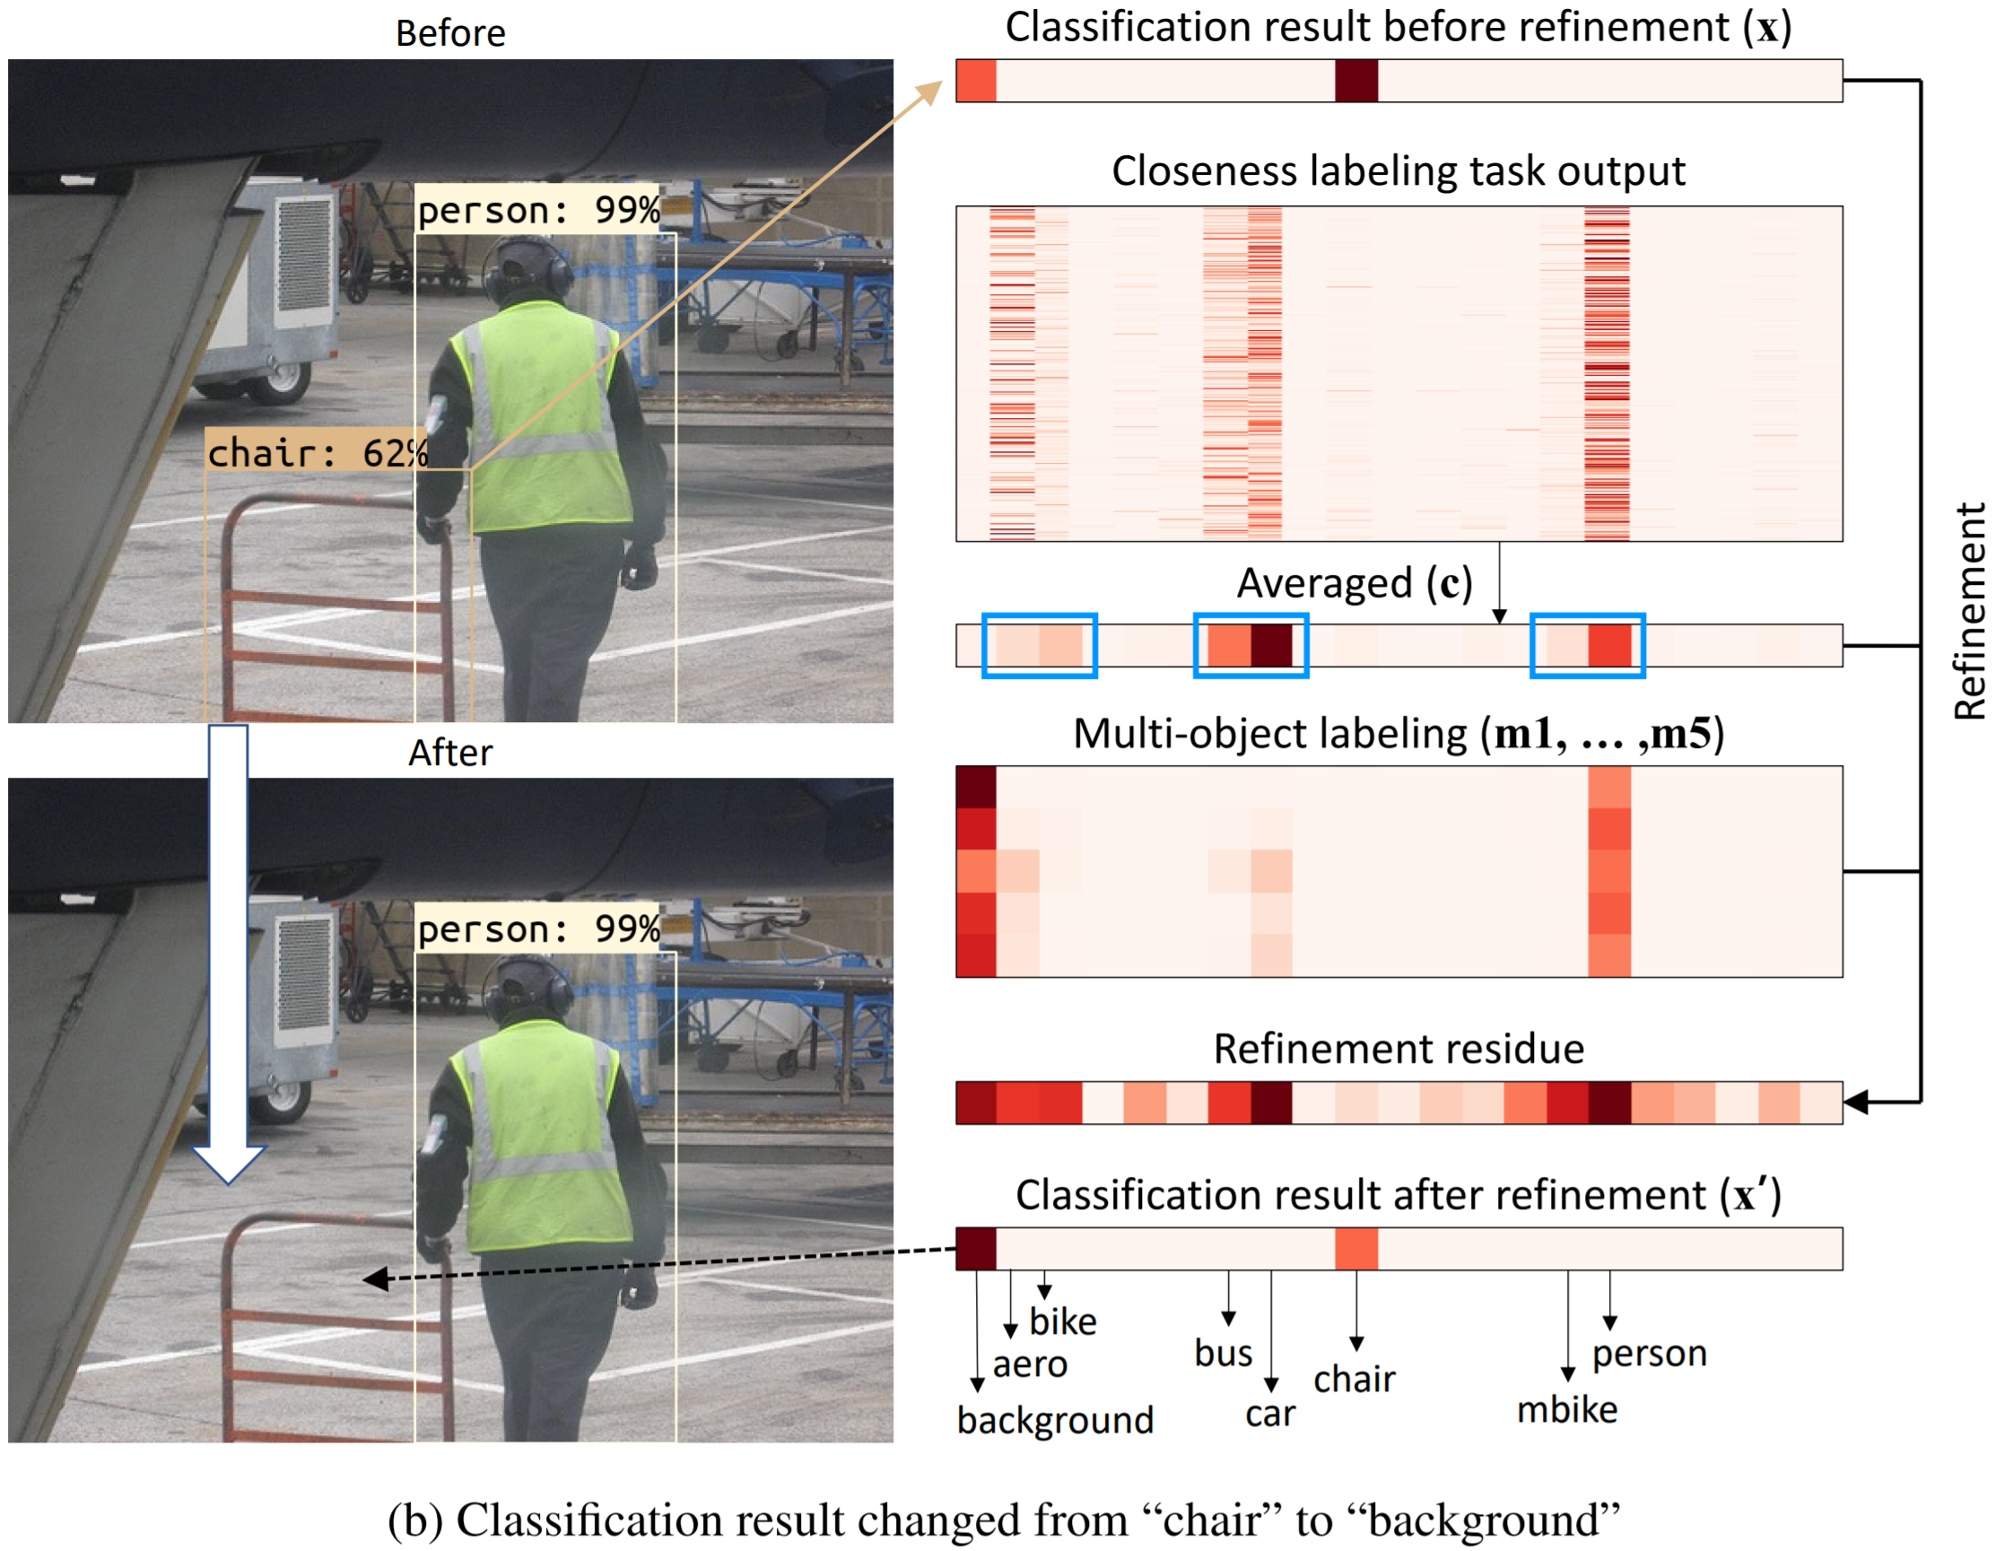
Visualization - Refinement
By closeness labeling task

Slide 14
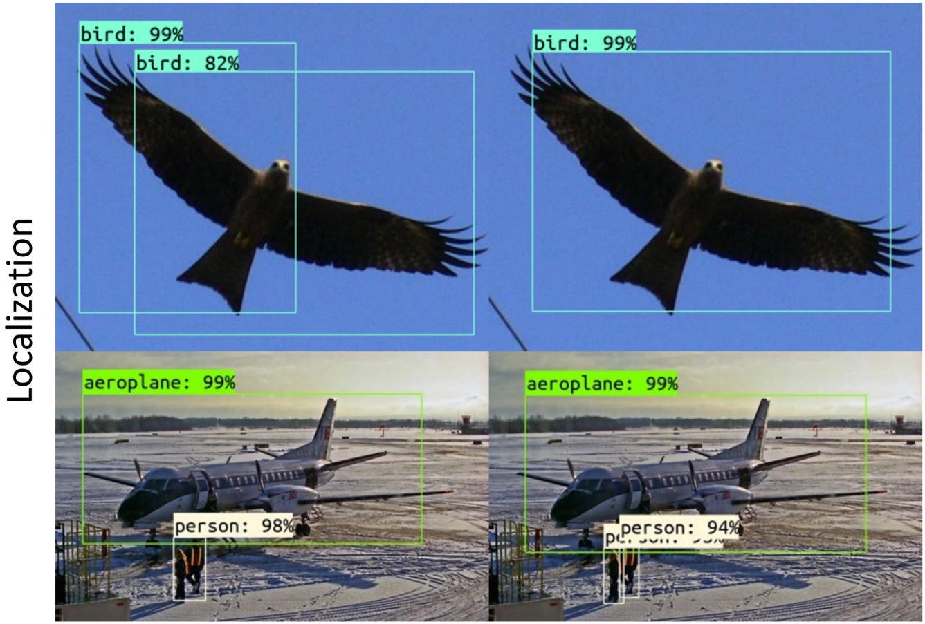
Visualization

Slide 15
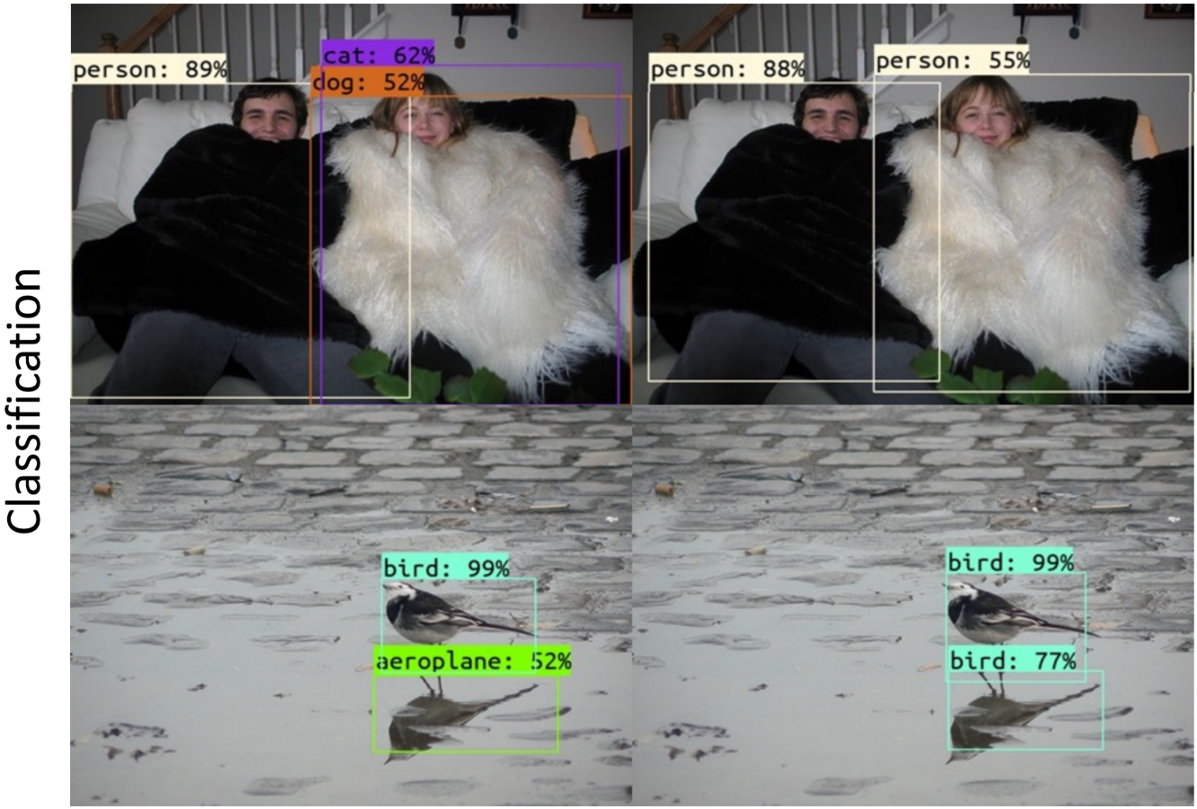
Visualization

Slide 16
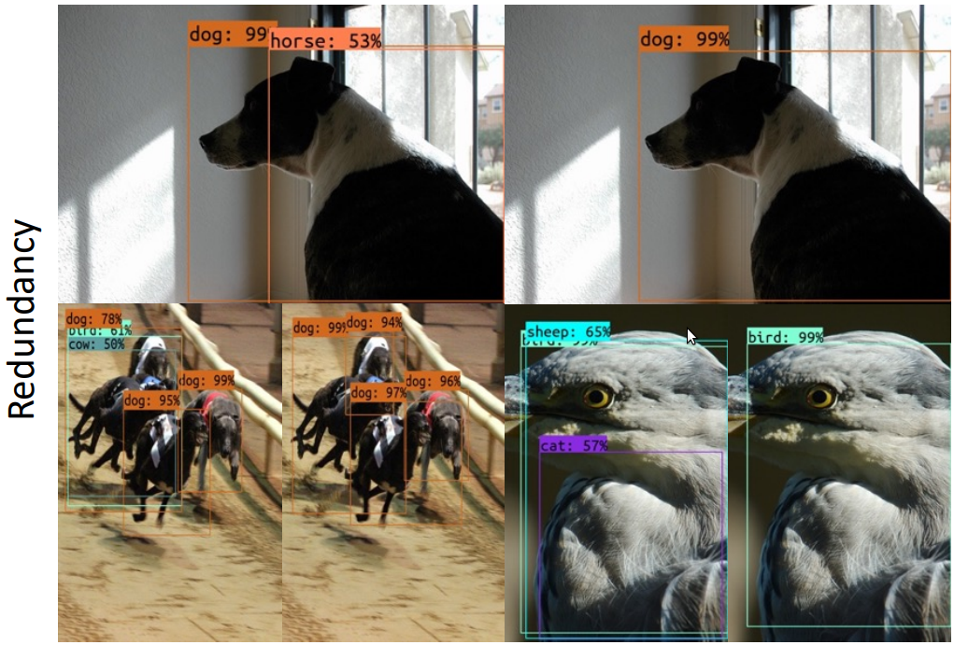
Visualization

Slide 17
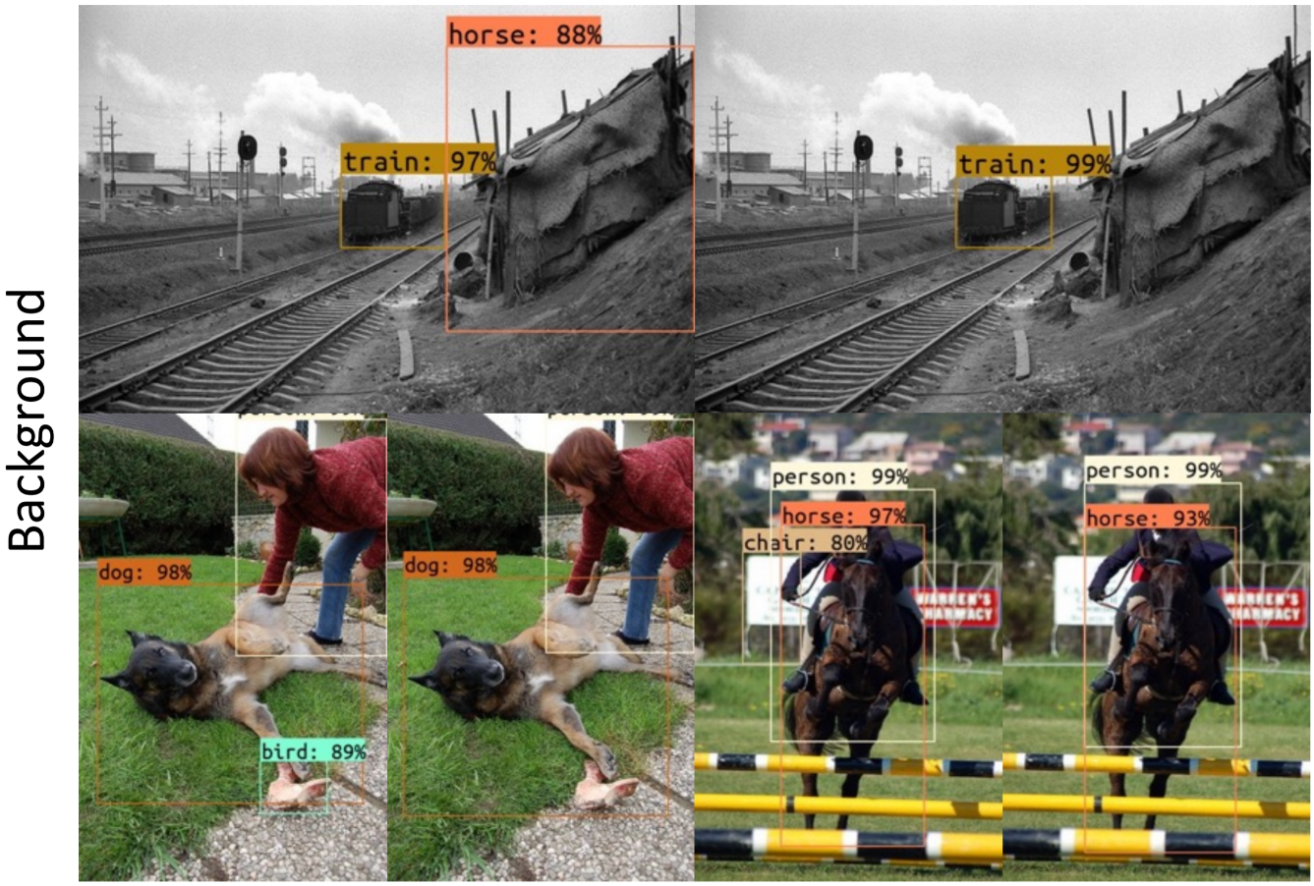
Visualization

Slide 18
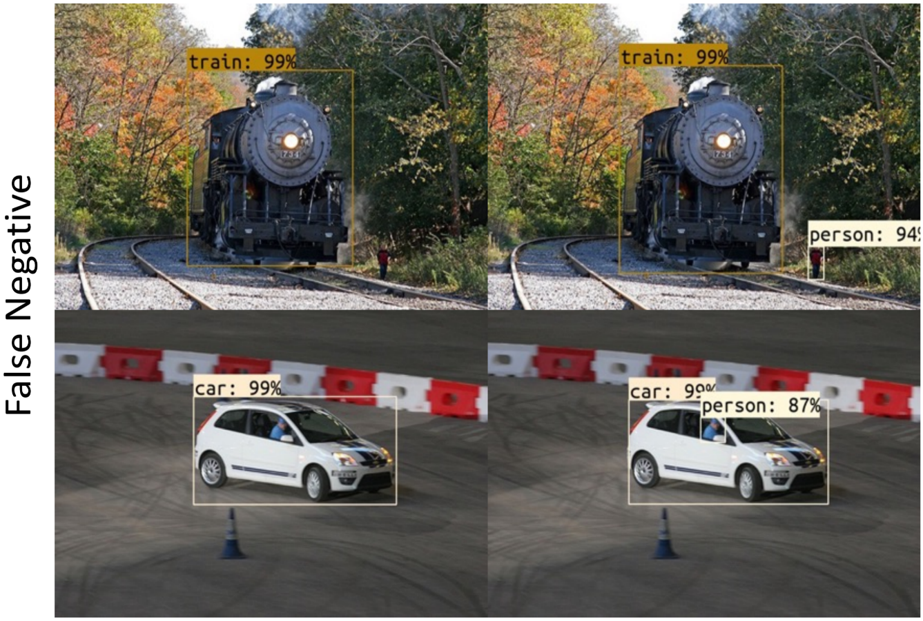
Visualization

Slide 19
Q & A
Thank You!

